Slide 1
FINDINGS:
The IMR Chart suggests that POS performance is stable with time for both POS and All Patient Payments but the Moving Range chart shows some variations in process.
The MR Chart for POS shows few points touching LCL indicating the out-of-control process and a sharp rise indicates undertaking an investigation as it was out of control.
This I-MR Chart is chosen here for analysis as it is good for data with subgroup size one.

Slide 2
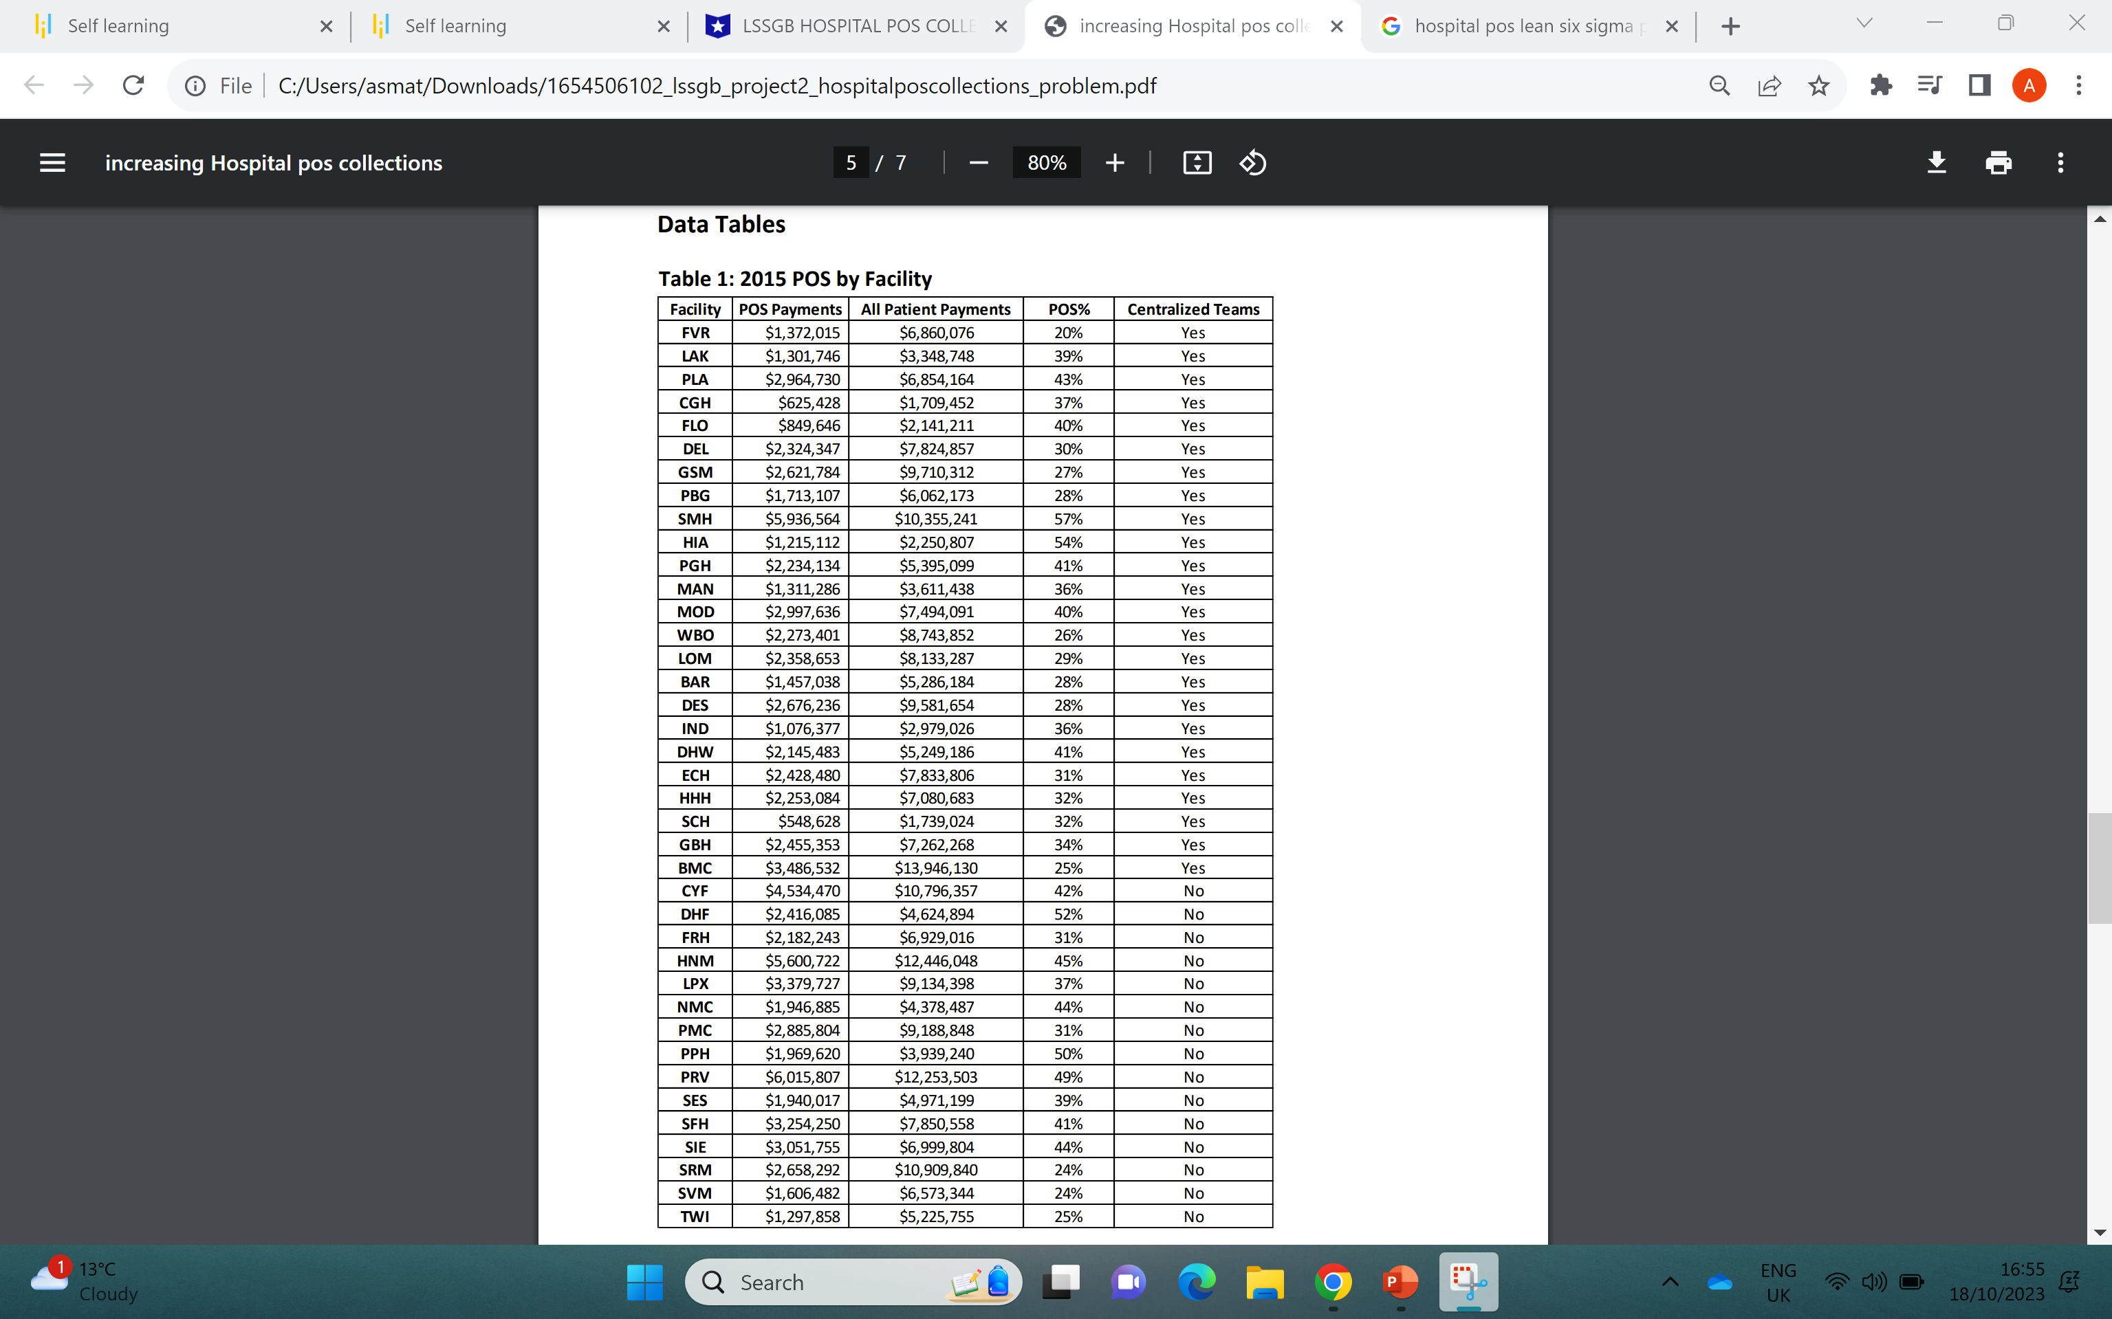
Exercise 2: Scope Opportunity Using the data given in Table 1, how would you scope the focus area of the project?

Slide 3
Exercise 2: Scope Opportunity Using the data given in Table 1, how would you scope the focus area of the project?
The data provided by HHS Operates 39 hospitals and clinics and the current POS Performance is 35.6% and the team has advised a 5% increase as a target of 40.6% to stay competitive.
From the data above in a table, it indicates that 13 clinics of HHS are above the target i.e. 40.6% so the remaining needs to be investigated for an increase in the percentage.
So this calls for hypothesis testing to be done to find whether there are centralized teams in HHS hospital facilities and clinics with POS target percentages and if there are centralized teams then to check the relation between the POS and the Centralized team and finally to check if the relation between these are statistically significant and practically significant or not?

Slide 4
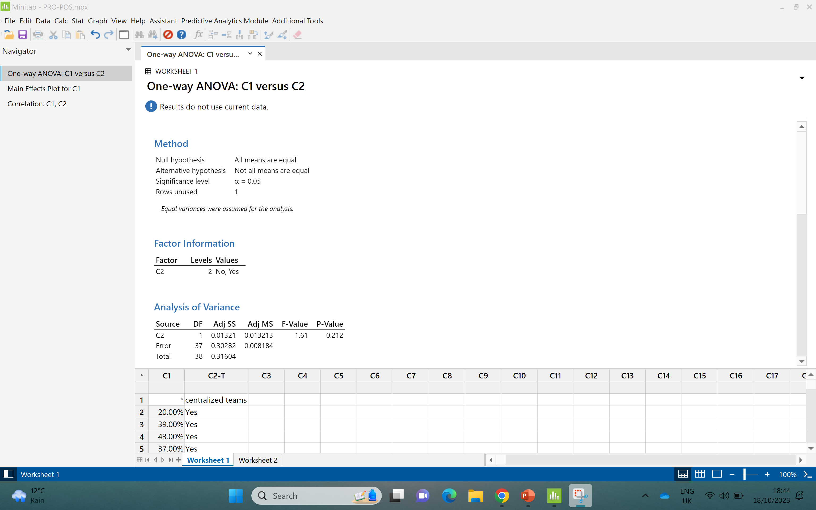
Exercise 3: Testing a Theory Use the data from Table 1 and conduct a hypothesis test to determine if centralized teams impact POS collections.
ONE WAY ANOVA TEST DONE

Slide 5
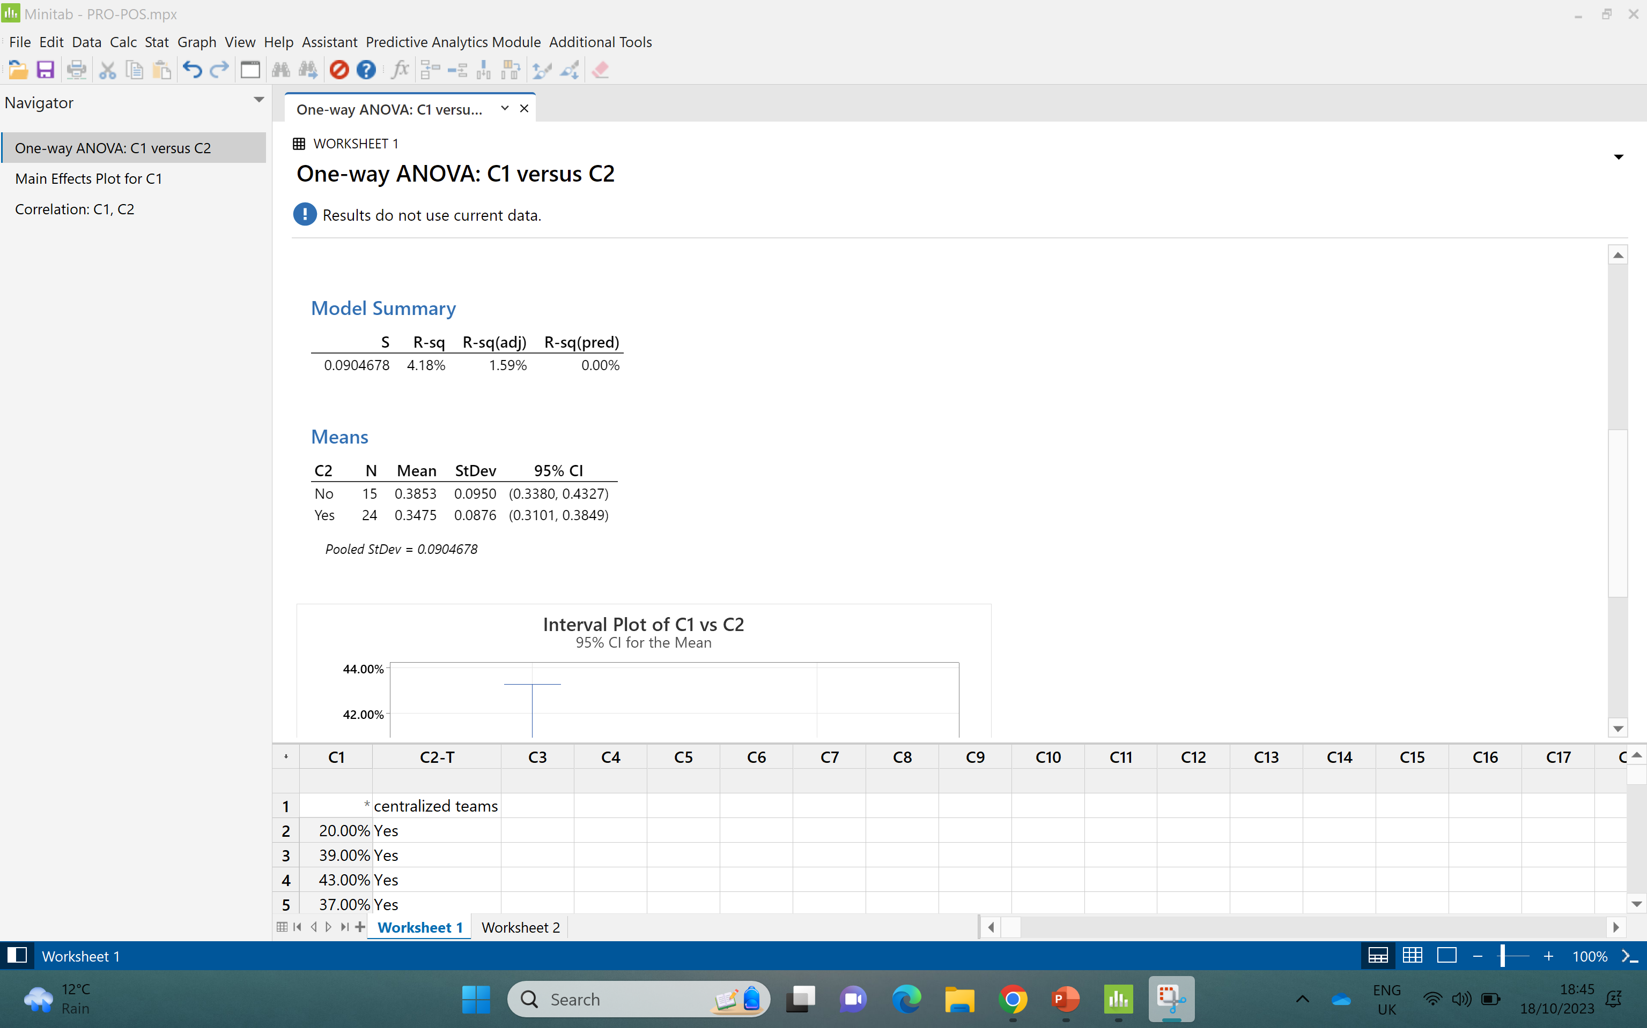

Slide 6
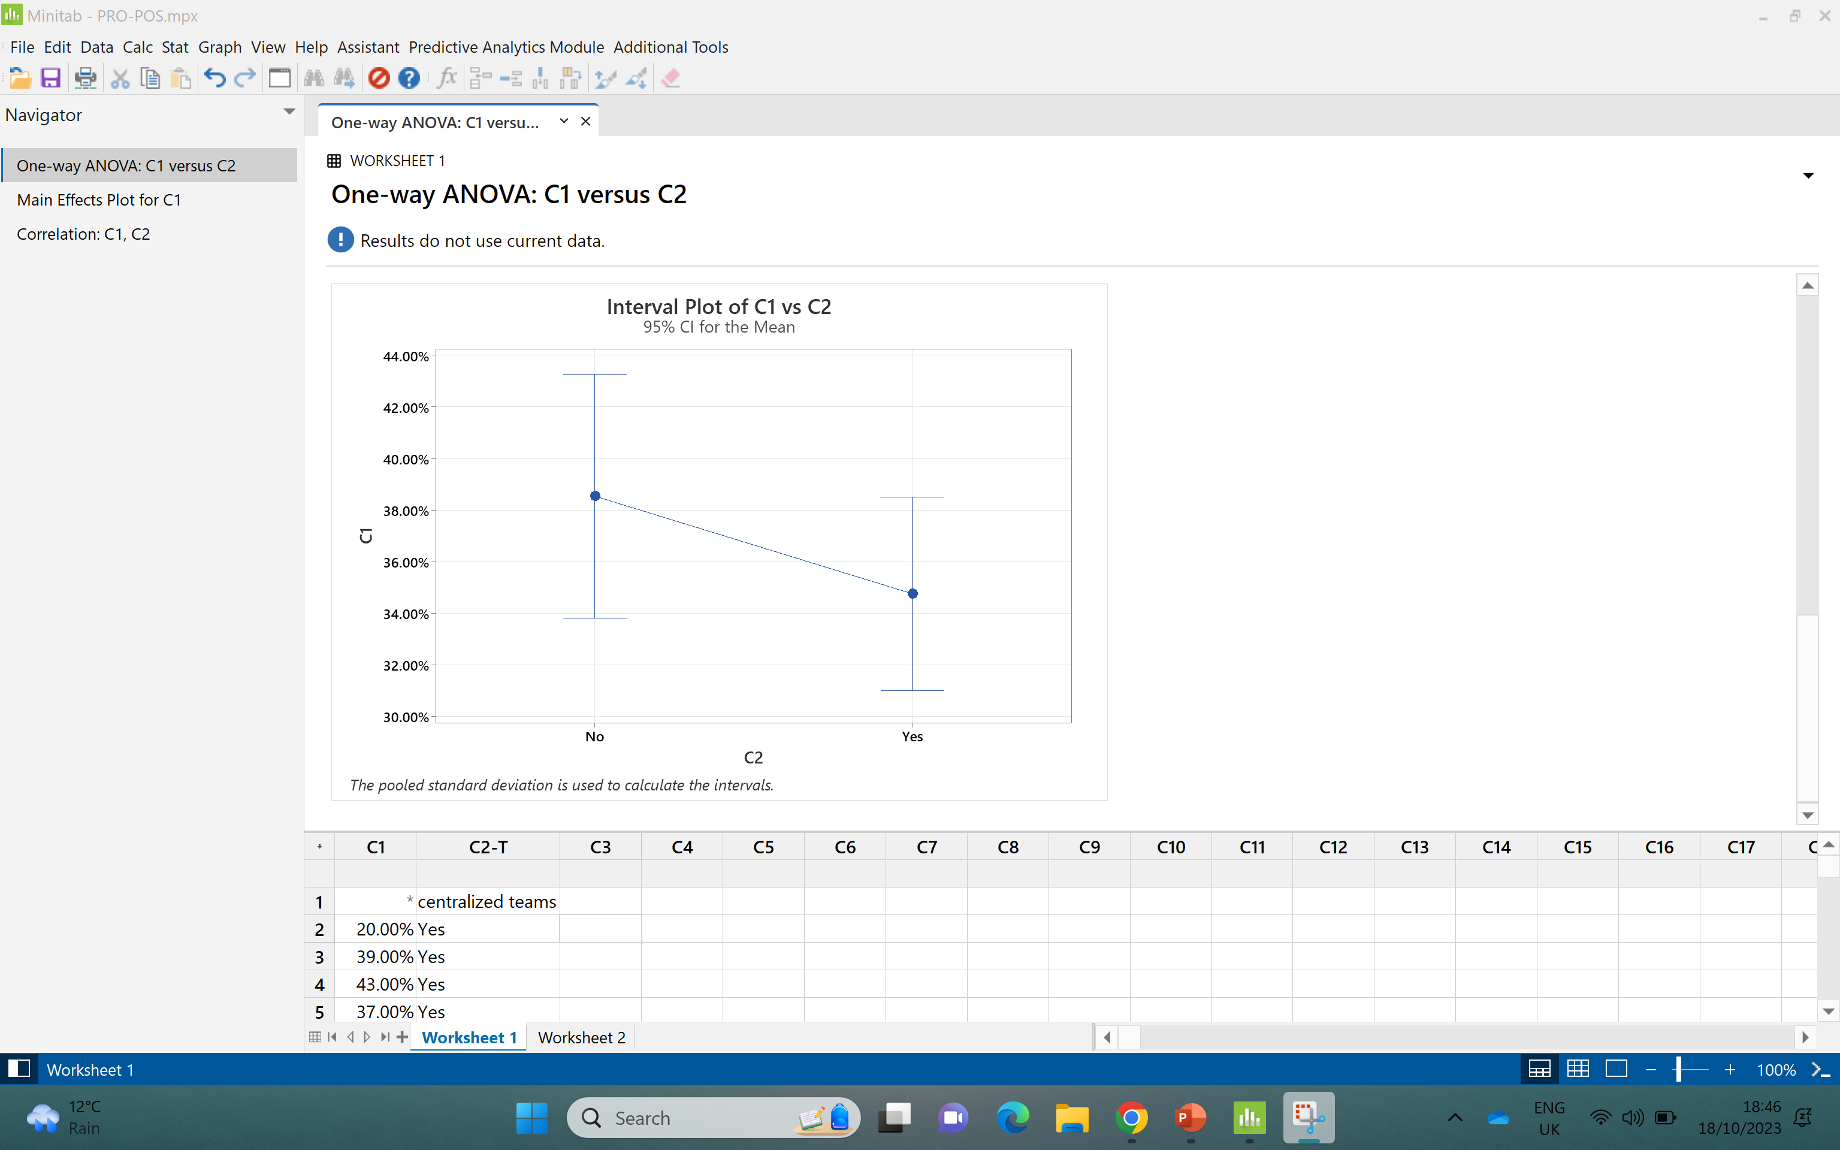

Slide 7
